Slide 1
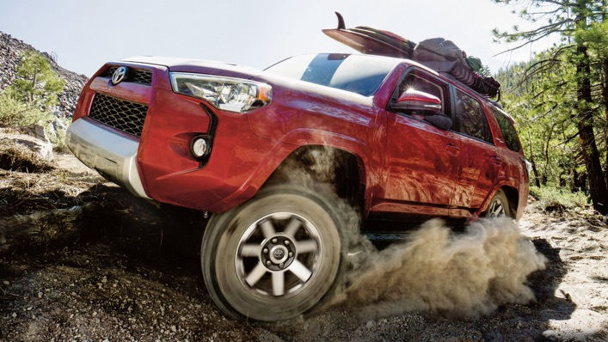
AGILE ORIGINS AND FUNDAMENTALS

Slide 2
DISCUSS…
QUIZ

Slide 3
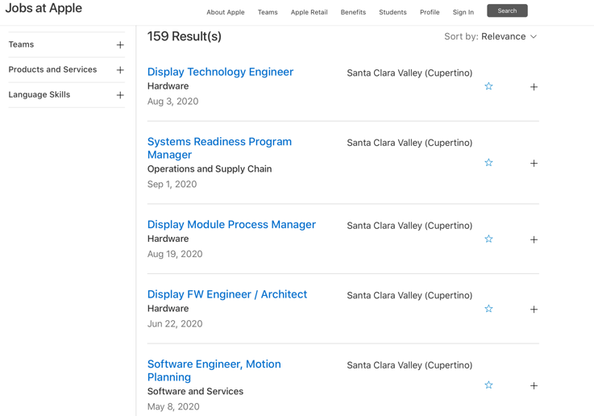
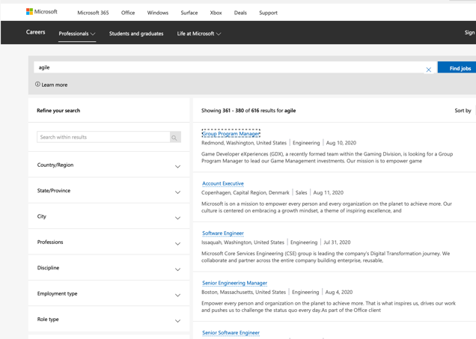
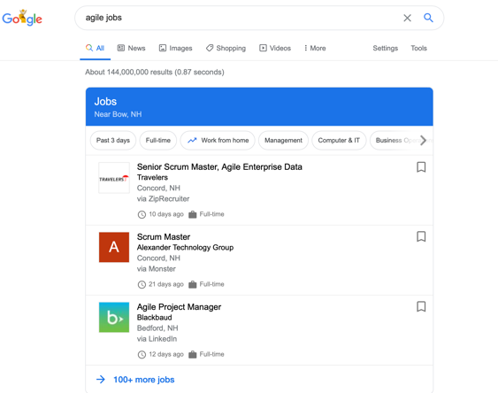


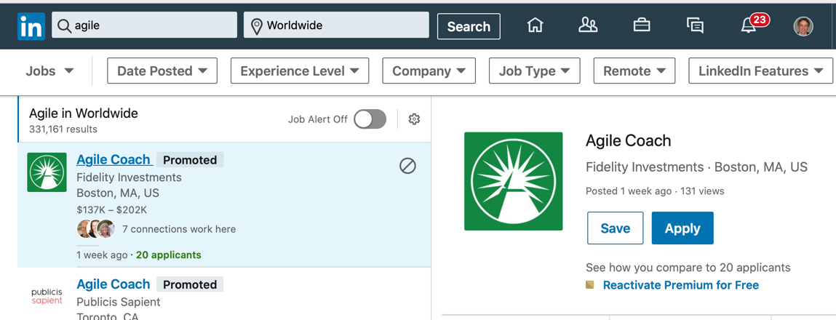
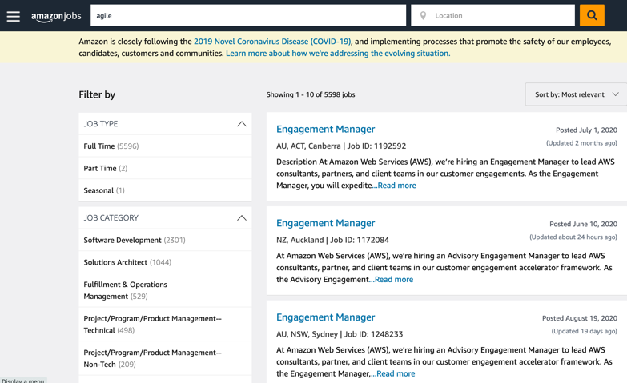
159 Postings
616 Postings
13+ Pages!
5,598 Postings
331,161 + Postings!!!!

Slide 4
AGILE ORIGINS

Slide 5
How Do Companies Survive?
What is their purpose?
What challenges are they facing to survive?

Slide 6
Modern Agile Movement Starts Forming in the 1920’s
Shewhart Cycle
Plan-Do-Study-Act
Walter A. Shewhart – 1920’s working in Bell Labs to improve quality of switching systems for telephone calls
Apply findings to current processes
Hypothesis
Statistical Analysis to Hypothesis and Results
Take action

Slide 7
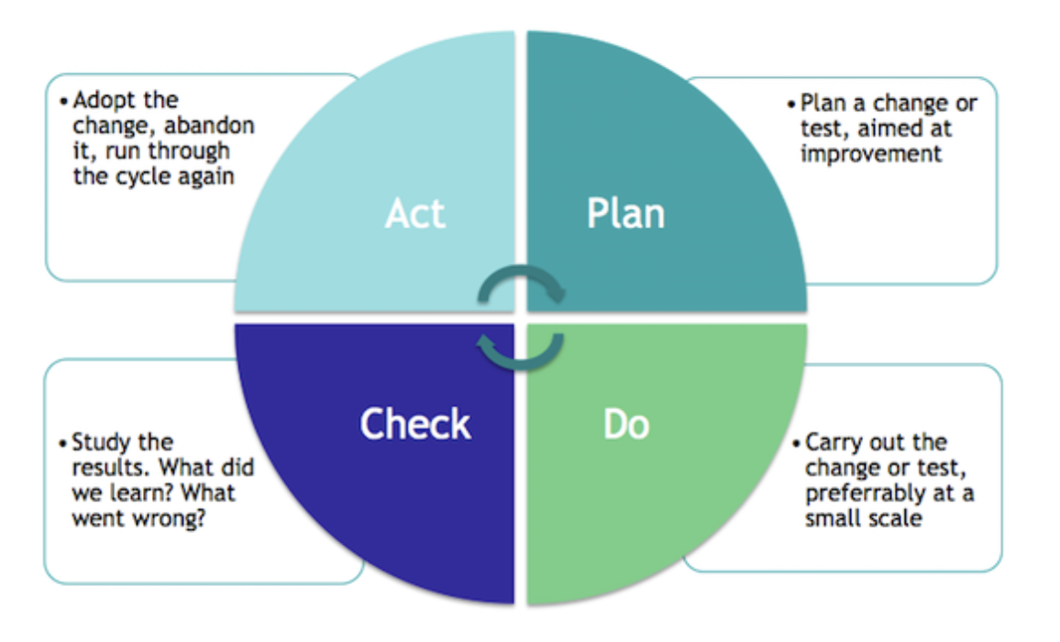
Deming Cycle
W. Edwards Deming reviews Shewhart’s work on statistical analysis and fully embraces Shewhart Cycle
Deming retrofits the Shewhart model to Plan-Do-Check-Act
Japan embraces the model, focusing upon quality improvement beginning in 1950
Limited resources
Work force challenges

Slide 8
Deming’s Legacy: Japan & Quality (TQM)

Slide 9
THE TOYOTA WAY
Taiichi Ohno, studies Ford’s manufacturing operations, comes back to Japan, eliminates waste in Ford’s operations and infuses Deming’s focus on quality throughout the development process. His Book, THE TOYOTA WAY, inspires further agile leaders
“Back at Toyota City, Ohno began experimenting. The first step was to group workers into teams with a team leader rather than a foreman. The teams were given a set of assembly steps, their piece of the line, and told to work together on how best to perform the necessary operations. The team leader would do assembly tasks as well as coordinate the team, and, in particular, would fill in for any absent worker—concepts unheard of in mass production plants… Ohno next gave the teams the job of housekeeping, minor tool repairs, and quality checking. Finally, as the last step when teams were running smoothly, he set time aside periodically for the team to suggest ways collectively to improve the process.” *
* “The Machine That Changed the World”, Womack, Jones, Roos

Slide 10
Mc Gregor’s Theory X & Theory Y
Mc Gregor’s Theory X and Theory Y
Auto Industry
Civil War (come back to highlight confederate calvary raids – beauregard?)
Steel w/ Carnegie
Theory X | Theory Y
Authoritarian Command and Control “Hands on” Micro Manager Motivation by Reward or Punishment | Participative Trustful Delagation “Guidance” Macro or “Zoom” Manager Intrinsic Value is a High Motivator
EXAMPLES: Assembly lines Rote Tasks Customer Service | EXAMPLES: Craftsman Creative and High Collaboration Occupations Medical(surgical/R&D), Software Engineering

Slide 11
American Industry Shifts
Decrease in manufacturing (blue collar) labor force
Increase of knowledge worker as percentage of the workforce
Fueled by computer revolution from military, aerospace, and large corporations
Examples:
IBM
NASA
Census
Guided Missile and Submarine Advancements
Shift to a Service Focused economy
Financial services
Hospitality
* Where Did All the Workers Go? 60 Years of Economic Change in 1 Graph, Derek Thompson, Atlantic Monthly, Jan 26, 2012

Slide 12
Milestone moment:
Hirotaka Takeuchi & Ikujiro Nonaka publish the New New Product Development Game in Harvard Business Review in January 1986. They outline how Incremental-Iterative development of products enable companies to be competitive through Speed and Flexibility.
6 Characteristics
built-in instability
self-organizing project teams
overlapping development phases
“multi-learning”
subtle control
organizational transfer of learning
“the new approach can act as a change agent: it is a vehicle for introducing creative, market-driven ideas and processes into an old, rigid organization.”*
*Takeuchi & Nonaka, The New New Product Development Game, HBR Jan 1986

Slide 13
The New New Product Development Game
1986
Harvard Business School – Takeuchi * Nonaka
6 Characteristics of Observed Agility
built-in instability
self-organizing project teams
overlapping development phases
“multi-learning”
subtle control
organizational transfer of learning
*Takeuchi & Nonaka, The New New Product Development Game, HBR Jan 1986

Slide 14
AGILE MOVEMENT IS FORGED
17 leaders of “Lightweight” product development frameworks such as SCRUM, XP, Feature Driven Development (FDD) among others gathered at Snowbird ski resort in February 2001.
The meeting resulted in the creation of AGILE MANIFESTO.

Slide 15
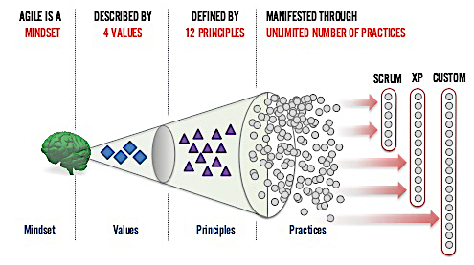
KANBAN

Slide 16
AGILE VALUES
INDIVIDUALS AND INTERACTIONS
over Processes and Tools
WORKING SOFTWARE
over Comprehensive Documentation
CUSTOMER COLLABORATION
over Contract Negotiation
RESPONDING TO CHANGE
over Following a Plan
That is, while there is value in the items on the right, we value the items on the left more.

Slide 17
KANBAN

Slide 18
AGILE PRINCIPLES
Our highest priority is to satisfy the customer through early and continuous delivery of valuable software (PRODUCT).
Welcome changing requirements, even late in development. Agile processes harness change for the customer’s competitive advantage.
Deliver working software (PRODUCT) frequently, from a couple of weeks to a couple of months, with a preference to the shorter time scale.
Business people and developers must work together daily throughout the project (EFFORT).

Slide 19
AGILE PRINCIPLES
Build projects around motivated individuals. Give them the environment and support they need, and trust them to get the job done.
The most efficient and effective method of conveying information to and within a development team is face-to-face conversation.
Working software (PRODUCT) is the primary measure of progress.
Agile processes promote sustainable development. The sponsors, developers, and users should be able to maintain a constant pace indefinitely.

Slide 20
AGILE PRINCIPLES
Continuous attention to technical excellence and good design enhances agility.
Simplicity – the art of maximizing the amount of work not done – is essential.
The best architectures, requirements, and designs emerge from self-organizing teams.
At regular intervals, the team reflects on how to become more effective, then tunes and adjusts its behavior accordingly.

Slide 21
UNDERSTANDING AGILE PRINCIPLES
When an Agile Principle has been identified for you, considering what that principle is stating.
Summarize that principles in JUST 3 WORDS

Slide 22
RECAP
Agile is the modern way companies are reorganizing to meet innovative and upstart competition in the marketplace. It’s origins began in the 1920’s and is present and needed by nearly every organization today. Shewhart’s origin idea of expanding and modernizing the scientific method with Plan-Do-Study-Act. W. Edwards Demings extended Shewhart’s idea into Plan-Do-CHECK-Act, into identifying and insisting a focus on quality Takeuchi & Nonaka identifies agile like companies with the article “The New New Product Development Game” in 1986 Agile Manifesto creation (4 Values; 12 Principles) in 2001

